Slide 1
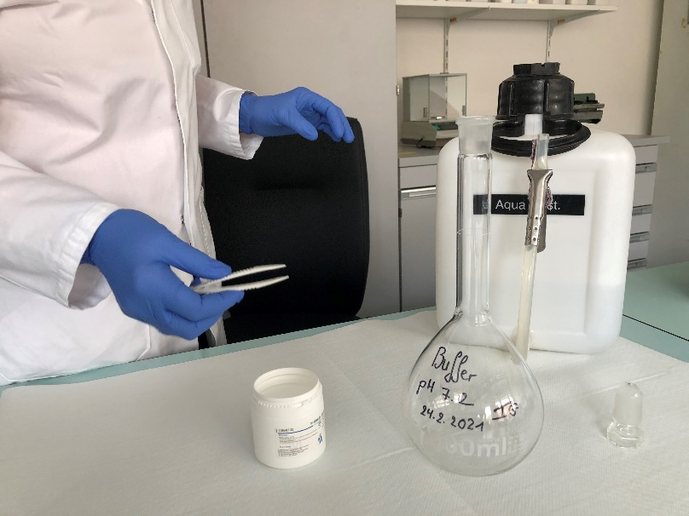
CORRECT BUFFER
Material:
Commercial phosphate buffer tablets for microscopy pH 7.2; e.g. Merck-Millipore (REF 1094680100)
Distilled or deionized water: 1L
Screw-capped 1L – glass bottle/beaker, clean and dry
Small forceps

Slide 2
LABELLING MALARIA BLOOD SMEARS
Use a lead pencil to write the informations on the frosted end of the slide.

Slide 3
PREPARATION OF BLOOD SMEARS FOR MALARIA
Material:
Gloves
(Pay attention to general precautions when handling blood!)
Glass slides: grease-free, with one frosted end, labelled with lead pencil
Micropipette (with measuring range 2-20 µl)
Slidetemplate (see ppt-slide 9)
Spreader slide: use a second glass slide
Methanol absolute, laboratory reagent grade or better
Notes:
1_2_1600.jpg Bildgrösse 9.36/12.5, Pos 12/6 Textfeld 10/12, Pos 1.5/5.50

Slide 4
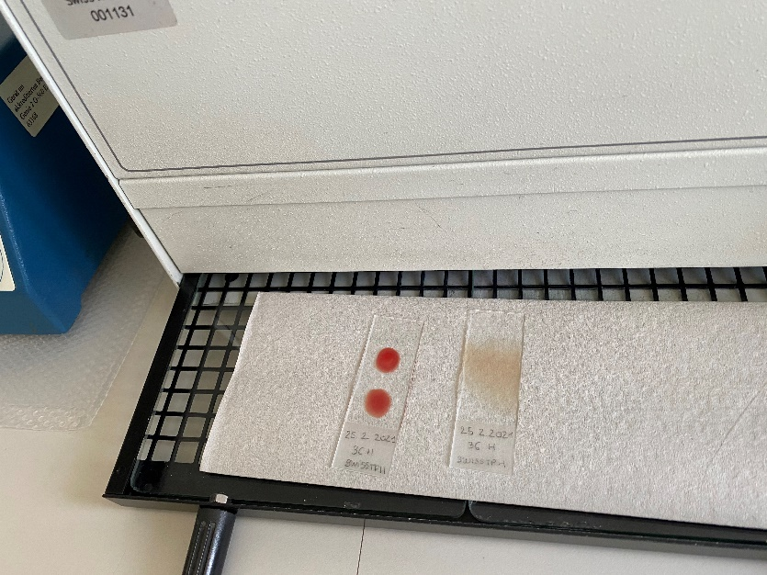
DRYING
Optional:
Use special device to
dry thick or thin smears
For example:
Small incubator 37°C
Heating plate (not over 37°C)
Rhesus swing
Notes:
1_21_1705.jpg

Slide 5
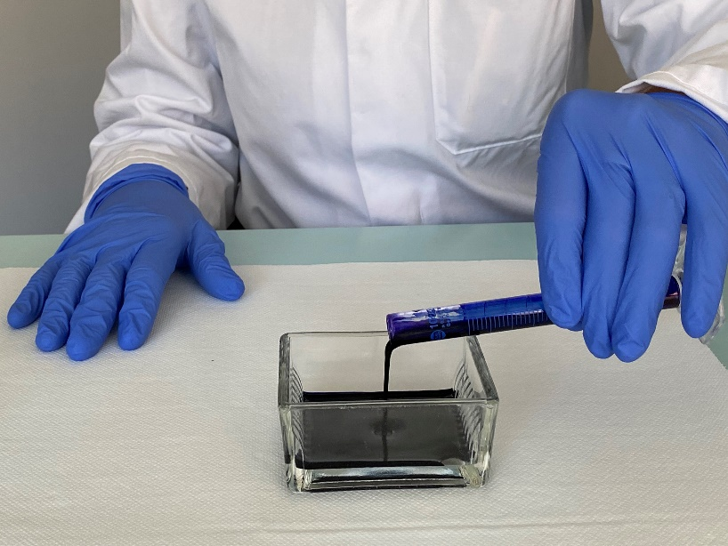
PREPARATION OF GIEMSA WORKING SOLUTION
Preparation of Giemsa
working solution
Transfer the filtered Giemsa into
the straining jar

Slide 6
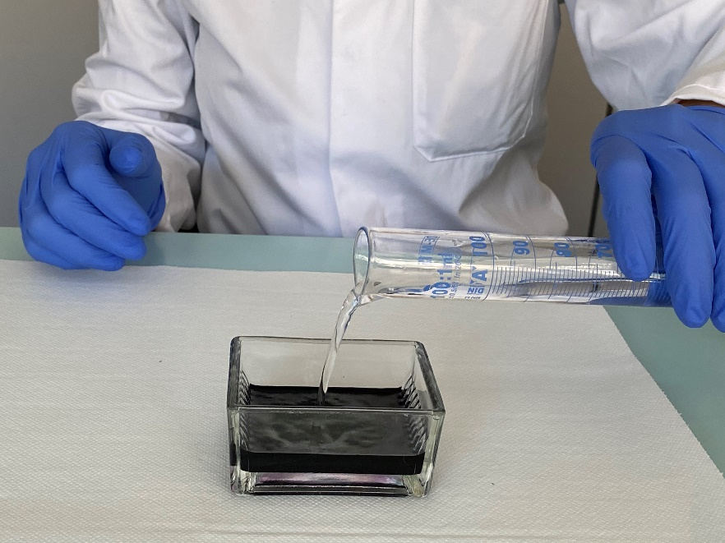
PREPARATION OF GIEMSA WORKING SOLUTION
Add the buffer to the staining jar containing the Giemsa stock solution.
→ Giemsa working solution is now ready to use

Slide 7
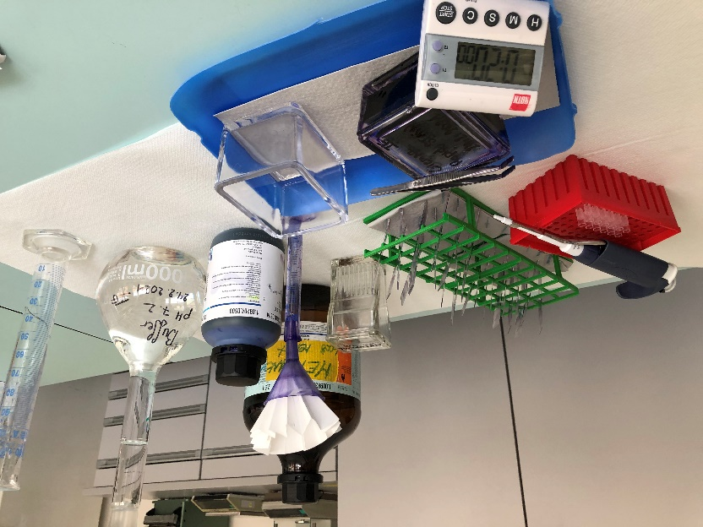
GIEMSA STAINING OF MALARIA BLOOD SMEAR
Material:
Staining jar with Giemsa staining solution (10 % solution)
(See SOP 010)
Timer
Slide drying rack or heating plate
Forceps
Jar containing tap water

Slide 8
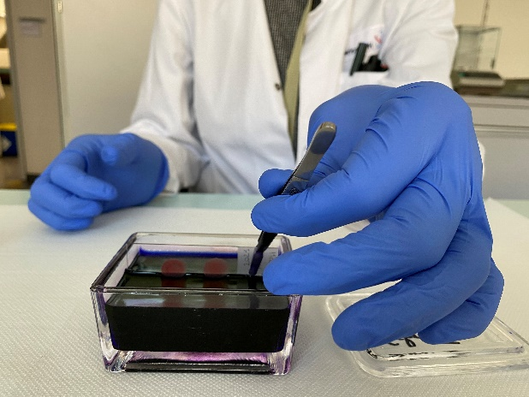
STAINING
Fill the staining jar with the Giemsa working solution.
Place thin and thick smear into
The staining jar.
Notes:
2_12a_2189.JPG und 2_12b_2196.JPG

Slide 9
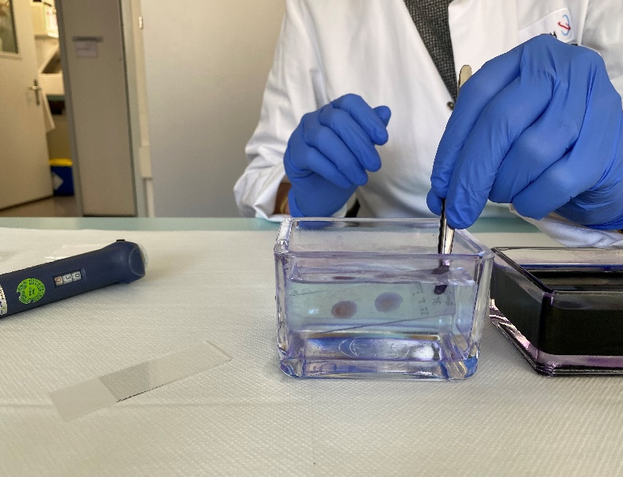
Rinsing in a jar containing tap water.
Notes:
2_14b_2207.JPG und 2_14c_2211.jpg

Slide 10
Now you’re ready to read the slides

